Slide 1
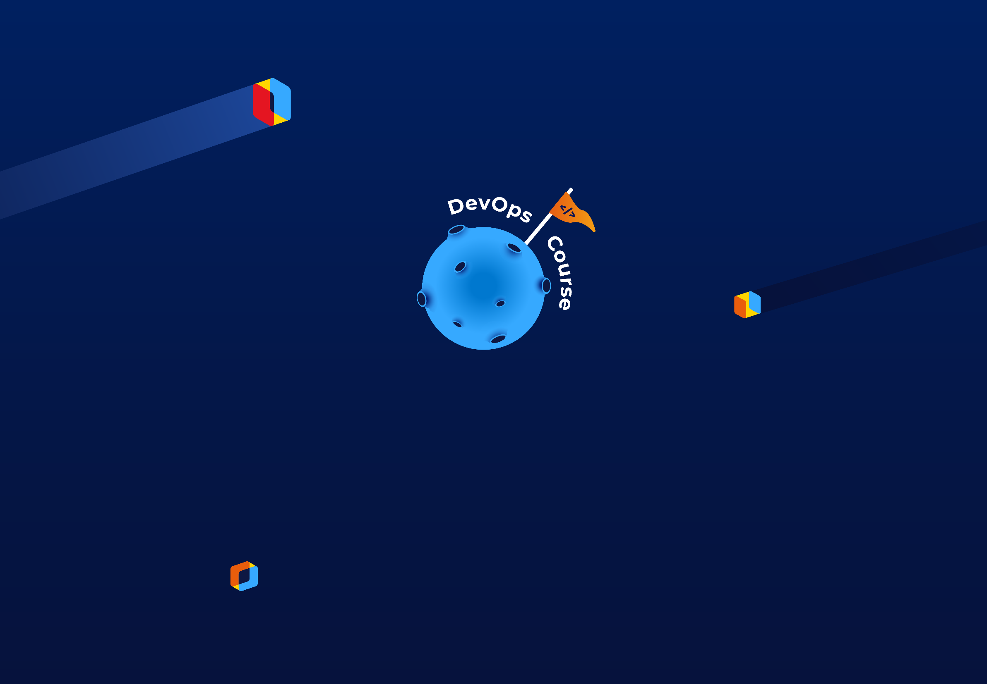
Урок вот-вот начнется.
Приготовься, сейчас будет что-то новенькое!

Slide 2


Cloud Watch
Amazon Web Services

Slide 3

AWS Cloud Watch

Slide 4

Outline
Interface
Monitoring
Management
Q&A

Slide 5
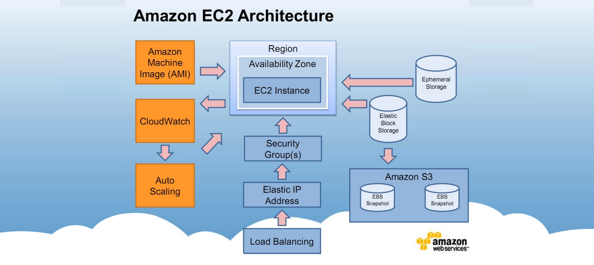
Amazon EC2
Architecture

Slide 6
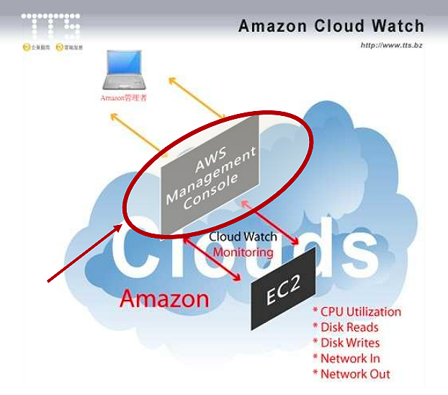
CloudWatch

Slide 7
It can monitor
Amazon EBS
Amazon EC2
Amazon RDS
Amazon SNS
Amazon SQS
Auto Scaling
Elastic Load Balancing

Slide 8
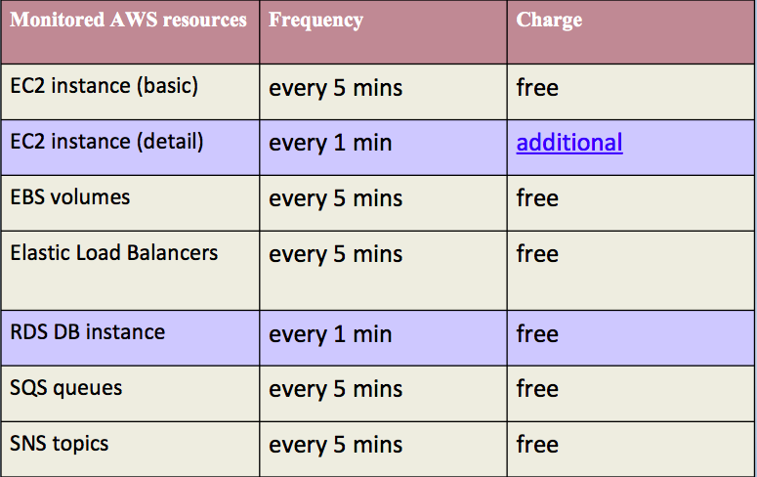
It can monitor

Slide 9
CloudWatch

Slide 10
Default Metrics
EC2 instance
CPUUtilization
DiskReadBytes
DiskReadOps
DiskWriteBytes
DiskWriteOps
NetworkIn
NetworkOut
EBS
CPUUtilization
DiskReadBytes
DiskReadOps
DiskWriteBytes
DiskWriteOps
NetworkIn
NetworkOut

Slide 11
CloudWatch Concepts
Metrics
Namespaces
Dimensions
Timestamps
Units
Statistics
Periods
Regions
Alarms

Slide 12
Metrics
Defined by
Name
Namespace
Dimensions
Time stamp
(Optionally) a unit of measure
Note:
Data come from any application or
business activity from which you collect data,
not just Amazon Web Services products and applications.

Slide 13
Retention period
Data points with a period of less than 60 seconds are available
for 3 hours. These data points are high-resolution custom metrics.
Data points with a period of 60 seconds (1 minute) are available
for 15 days
Data points with a period of 300 seconds (5 minute) are available
for 63 days
Data points with a period of 3600 seconds (1 hour) are available
for 455 days (15 months)

Slide 14
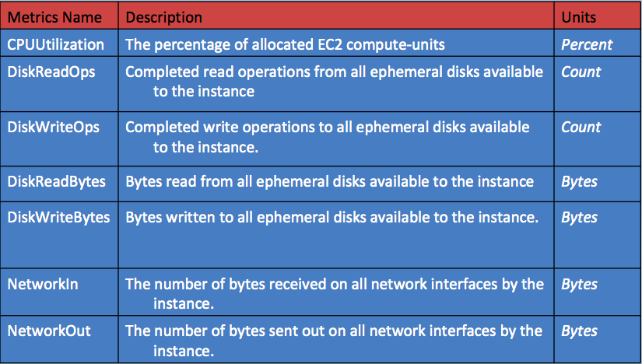
Metrics on EC2 instance

Slide 15
Namespaces
Conceptual containers for metrics
Isolated from different namespaces
Namespace name:
Valid XML characters: 0-9A-Za-z .
_ / # : – AWS services: AWS/
Less than 256 characters in length
No default namespace, specified eac

Slide 16
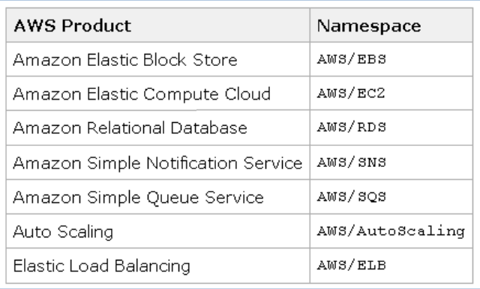
Namespaces examples

Slide 17
Dimensions
Categories for metrics’ characteristics
Name/value pair
Default metrics
Can aggregate data across all dimensions
Up to ten dimensions to a metric

Slide 18
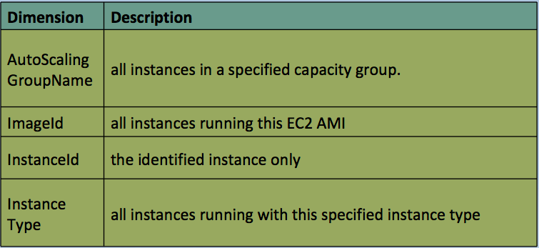
Dimensions on EC2 instance

Slide 19
Timestamps
Each metric data point must be marked with a time stamp
Valid Ranges:
up to two weeks in the past
up to one day in the future
By default, CloudWatch creates a time stamp based on the time
the data was received
Note:
Better to provide the time stamp under UTC
Statistics from CloudWatch, all times reflect the UTC time zone.

Slide 20
Units
Statistic's unit of measure
Common unit:
Seconds
Bytes
Bits
Percent
Count
Bytes/Second (bytes per second)
Bits/Second (bits per second)
Count/Second (counts per second)
None (default when no unit is specified)

Slide 21
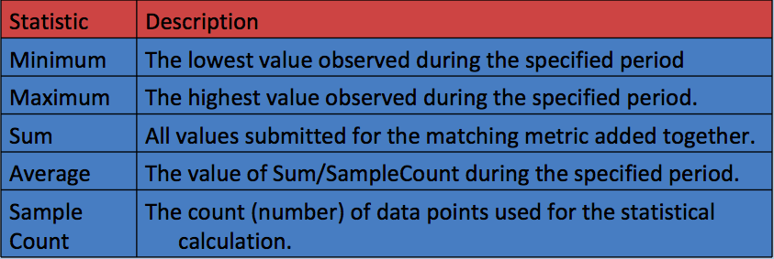
Statistics
Metric data aggregations over specified periods of time

Slide 22
Periods
Length of time for a specific statistic
Duration
Short as one minute (60 seconds)
Long as two weeks (1,209,600 seconds)
StartTime & EndTime
To determine how many periods

Slide 23
Regions
Each Amazon Region
Completely isolated from the others
CloudWatch does not aggregate data across Regions
Metrics are completely separate between Regions

Slide 24
Custom Metrics
Generate your data points
Like: PageViewCount
Publish your custom metrics
“mon-put-data” API

Slide 25
CloudWatch Logs
Amazon CloudWatch Logs lets you monitor and troubleshoot
your systems and applications using your existing system,
application and custom log files.
With CloudWatch Logs, you can monitor your logs, in near real time,
for specific phrases, values or patterns.

Slide 26
Alarms
Watches a single metric over a specified time period
Performs one or more actions
Based on the value of the metric to a given threshold over
a number of time periods
Action:
A notification sent to an SNS topic or Auto Scaling policy
Invoke actions for sustained state changes only
Specify the period over which the comparison is made
Specify how many consecutive periods the threshold must be
breached before you are notified

Slide 27
Alarm State
OK
The metric is within the defined threshold
ALARM
The metric is outside of the defined threshold
INSUFFICIENT_DATA
The metric is not available, alarm started
Not enough data is available for the metric
to determine the alarm state

Slide 28
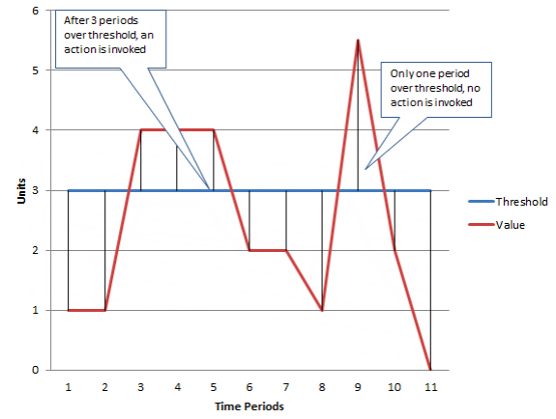
Let’s analyze

Slide 29
Alarms Features
Create
Up to 400 alarms per AWS account
List
Any or all of the currently configured alarms list
Any alarms in a particular state
Flter the list by time range
Disable/enable
Test an alarm by setting it to any state
This temporary state change lasts only until the next
Alarm comparison occurs
View an alarm's history
CloudWatch preserves alarm history for two weeks
Each state transition is marked with a unique time stamp
The time stamp helps to confirm unique state changes

Slide 30
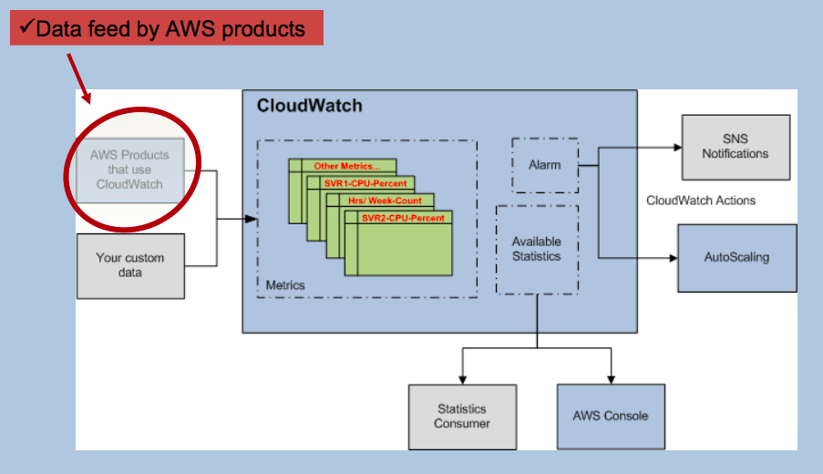
General View

Slide 31
Pricing
Detailed Monitoring for EC2 instances
at one-minute frequency
7 pre-defined metrics per instance
$3.50 per instance per month (=$0.50*7)
Custom Metrics
$0.50 per metric per month
Alarms
$0.10 per alarm per month
API Requests
$0.01 per 1,000 Get, List, or Put requests Free Tiers
Basic Monitoring metrics (at five-minute frequency)
All customers (each month)
10 metrics; 10 alarms; 1 million API requests

Slide 32


Questions ?

Slide 33

Thanks for attention!

